Slide 1
Component-based Software Engineering
Hands-on Exercise

Slide 2
Hands-on Exercise 1: Building a Component-Based E-Commerce API
Objective:
  Develop a basic e-commerce API with components for managing products and orders
  Reinforcing CBSE principles such as modularity, reusability, and composition using Spring Boot.

Slide 3
Overview
We will build a simple e-commerce API that allows users to:
  Retrieve a list of products (GET /products).
  Add a new product (POST /products).
The application will consist of three main components:
  Product Model: Represents the data structure for products.
  ProductRepository: Handles data storage (in-memory for simplicity).
  ProductService: Encapsulates business logic.
  ProductController: Exposes REST endpoints.

Slide 4
Software Tools Needed
IDE: IntelliJ IDEA, VS Code, or Eclipse with Spring Tools Suite.
Dependencies: Spring Web, Spring Data JPA, H2 Database (via Spring Initializr).
Testing Tool: Postman

Slide 5
Step 1: Set Up a Spring Boot Project
Go to Spring Initializr.
Configure the project:
  Project: Maven.
  Language: Java.
  Spring Boot Version: Latest stable (e.g., 3.4.4).
  Group: com.example.
  Artifact: ecommerce-api.
  Dependencies: Add Spring Web, Spring Data JPA, and H2 Database.
Generate and download the project, then open it in your IDE.
Verify the project runs by executing the main class (EcommerceApiApplication.java) and checking for the Spring Boot banner in the console.

Slide 6
Step 2: Define a Product Model
Goal: Create a data model to represent products in the e-commerce system.
Create a new package com.example.ecommerceapi.model.
Add a Product class with fields for id, name, price, and stock.
Include getters, setters, and a constructor.

Slide 7
Step 3: Create ProductRepository
Goal: Build a repository component to manage product data (in-memory for simplicity).
Create a new package com.example.ecommerceapi.repository.
Define a ProductRepository class annotated with @Repository.
Implement basic CRUD operations: findAll() and save() using an in-memory List.

Slide 8
Step 4: Create ProductService
Goal: Implement a service component to handle business logic for product management.
Create a new package com.example.ecommerceapi.service.
Define a ProductService class annotated with @Service.
Inject ProductRepository via constructor injection and implement methods to retrieve and add products.

Slide 9
Step 5: Create ProductController
Goal: Build a REST controller to expose product management endpoints.
Create a new package com.example.ecommerceapi.controller.
Define a ProductController class annotated with @RestController.
Inject ProductService and implement GET and POST endpoints.

Slide 10
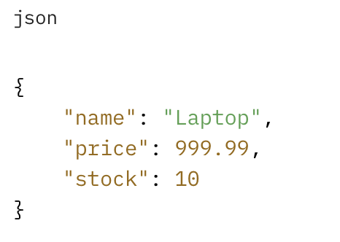
Step 6: Test the API Using Postman
Goal: Verify the API works as expected.
Start the Spring Boot application (run EcommerceApiApplication).
Open Postman:
  GET Request:
    URL: http://localhost:8080/products
    Method: GET
    Expected Response: Empty list [] (initially).
  POST Request:
    URL: http://localhost:8080/products
    Method: POST
    Body (raw JSON):
    Expected Response: Product with an assigned id (e.g., {"id": 1, "name": "Laptop", "price": 999.99, "stock": 10}).
Repeat the GET request to confirm the product was added.

Slide 11
Hands-on Exercise 1: Summary
Components: ProductRepository, ProductService, and ProductController are modular, reusable units.
Interfaces: Implicitly applied through Spring’s dependency injection (e.g., ProductService could use an interface in future iterations).
Composition: Dependency injection assembles the components into a cohesive API.
CBSE Principles: Encapsulation (repository hides data storage), modularity (separate concerns), and reusability (components can be reused in other contexts).

